Slide 1
Turner in Kent

Slide 2
J.M.W. Turner 1775 – 1851 : self portrait c.1799 Tate Britain

Slide 3
Richard Horwood’s map of London 1799 showing Turner’s birthplace at 21 Maiden Lane on the 23 April 1775. The house no longer exists but the site is marked by a blue plaque.

Slide 4
Canterbury, 1762 W. & H. Doigge

Slide 5
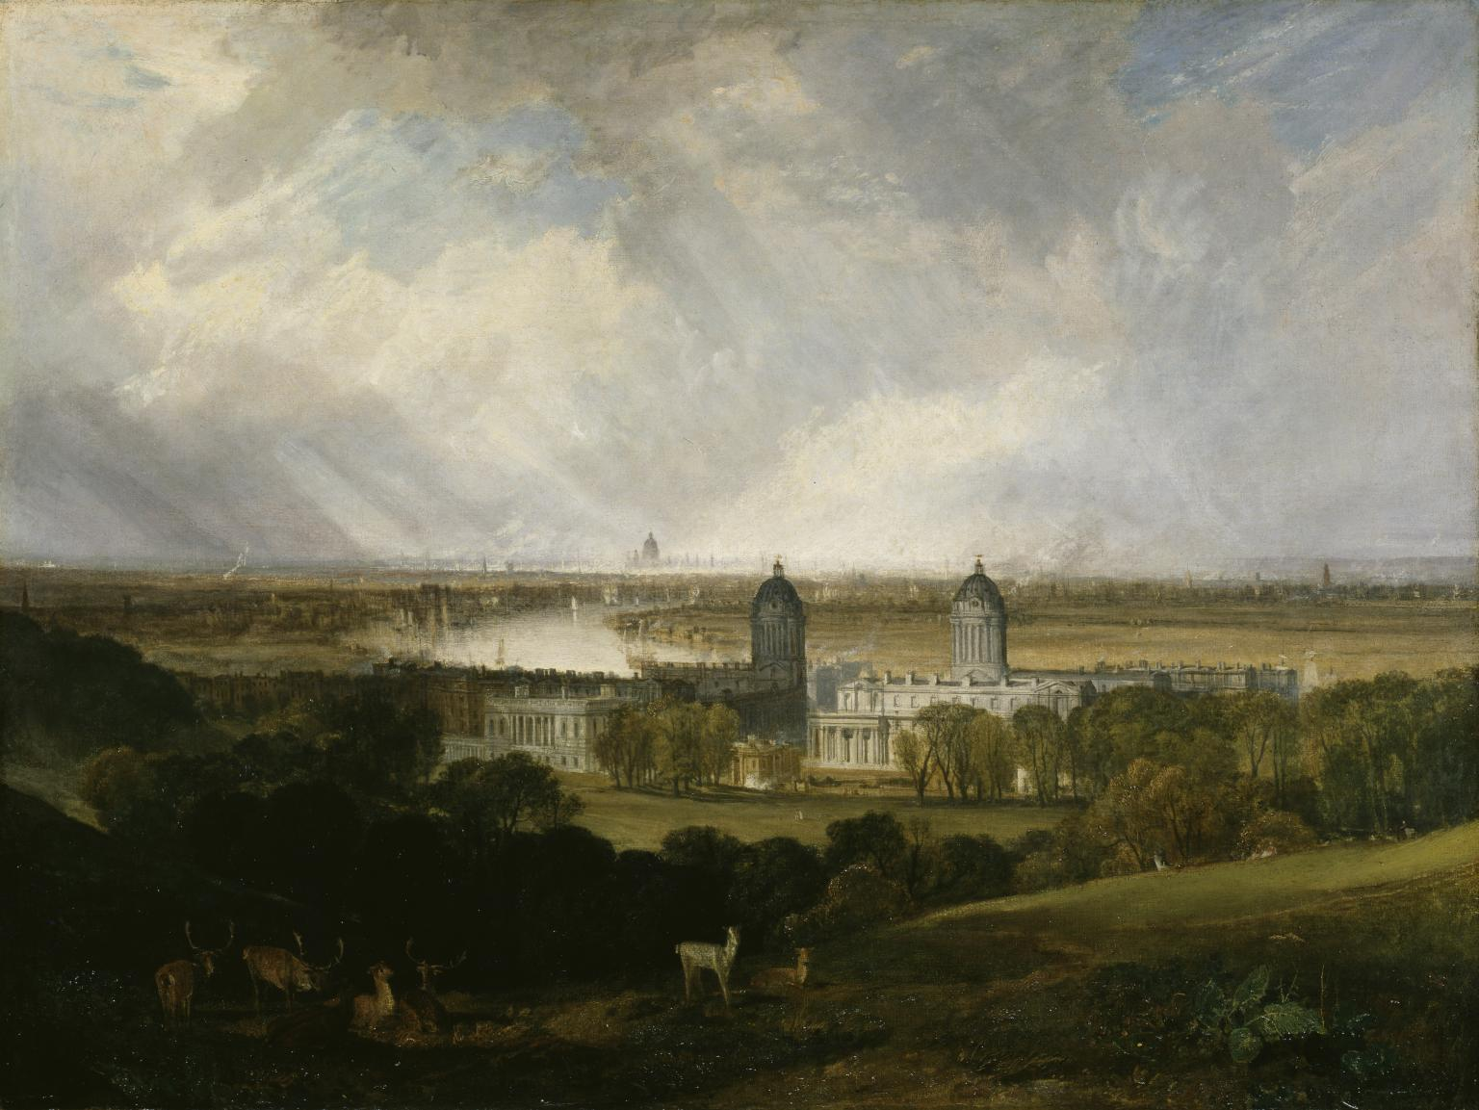
Greenwich Hospital from the Park, c.1809, and painting exhibited at RA in 1809. Tate Britain.

Slide 6
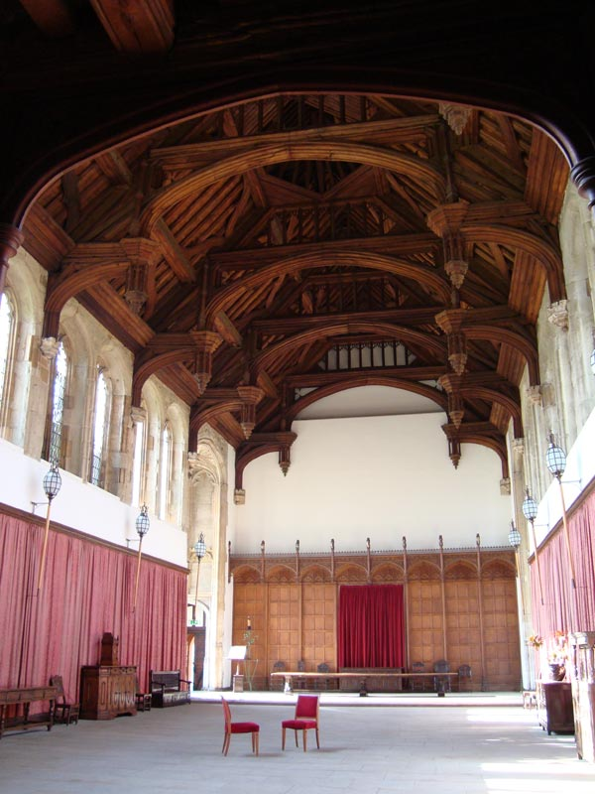
Turner: Interior of ‘King John’s’ Palace at Eltham, c.1791 Yale Centre for British Art A watercolour of Eltham Palace hall was exhibited in the Royal Academy in that year.

Slide 7
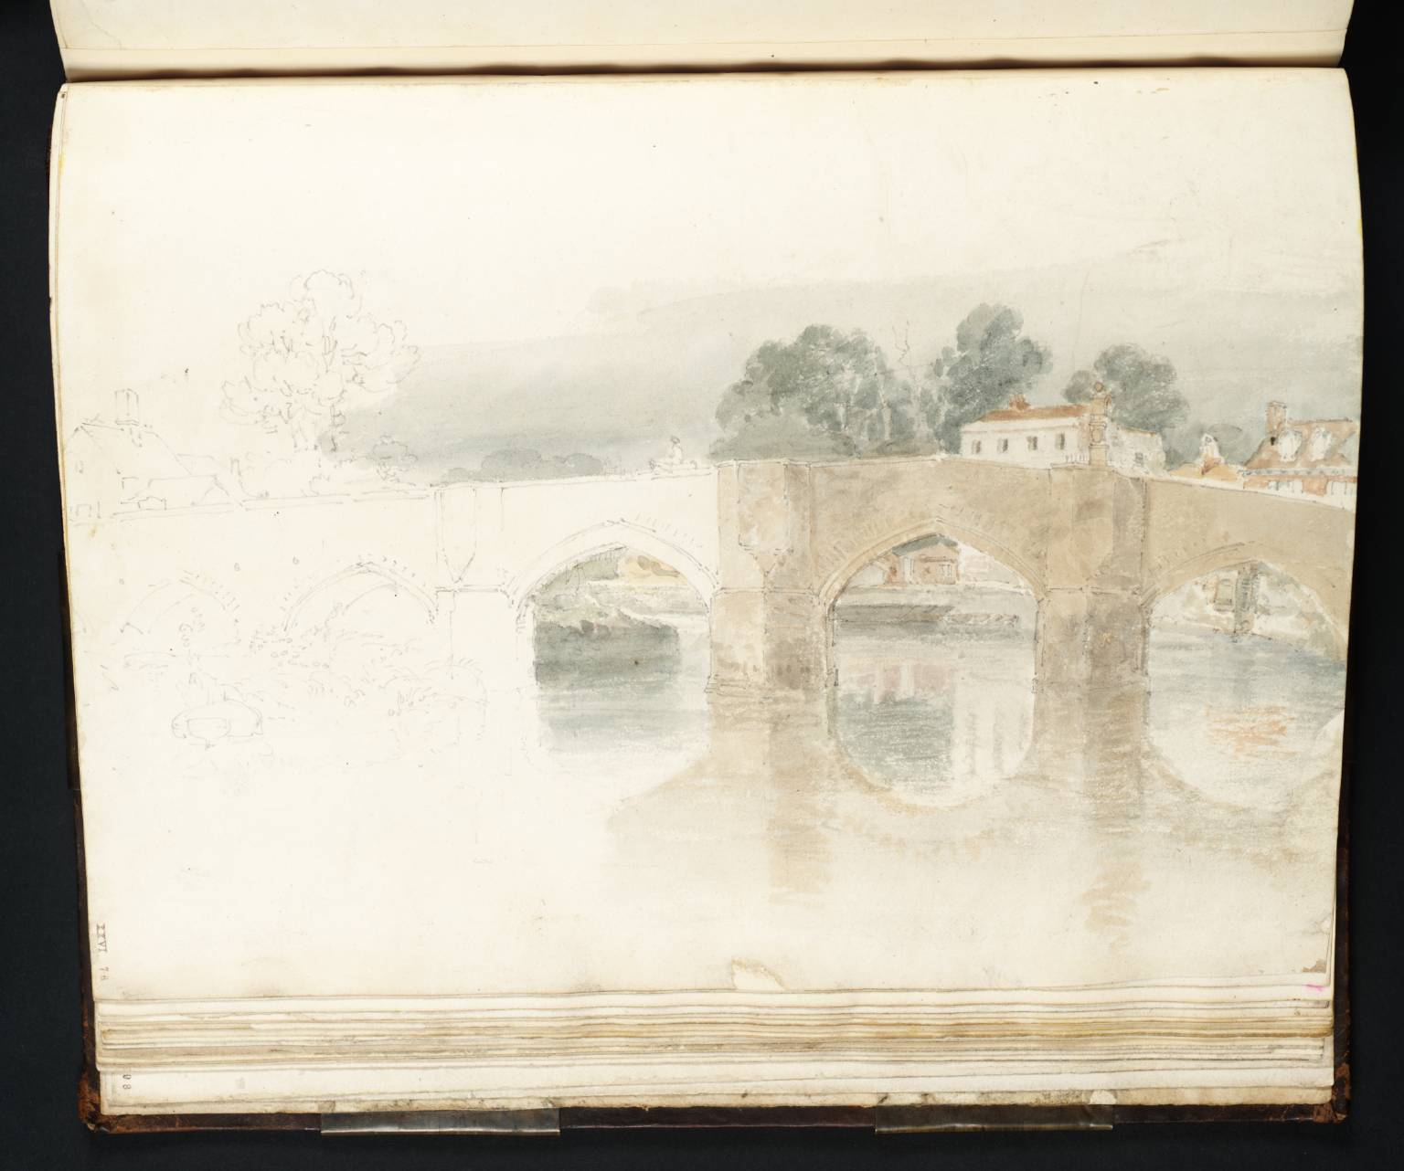
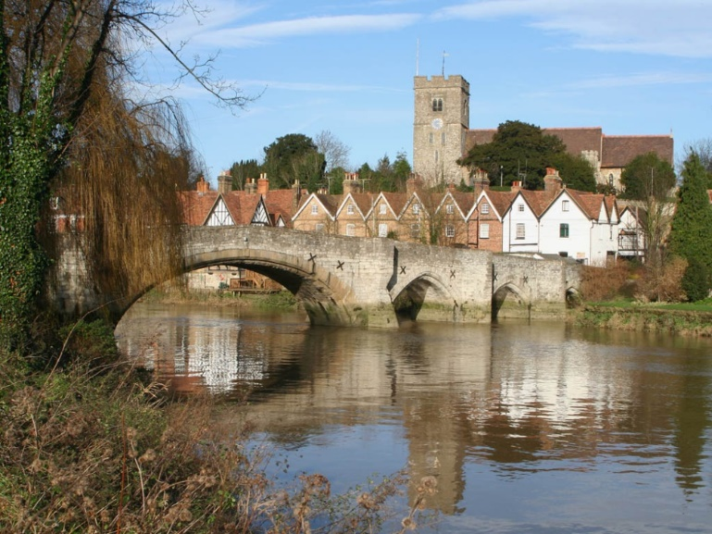
Aylesford Bridge c.1798 Tate Britain

Slide 8
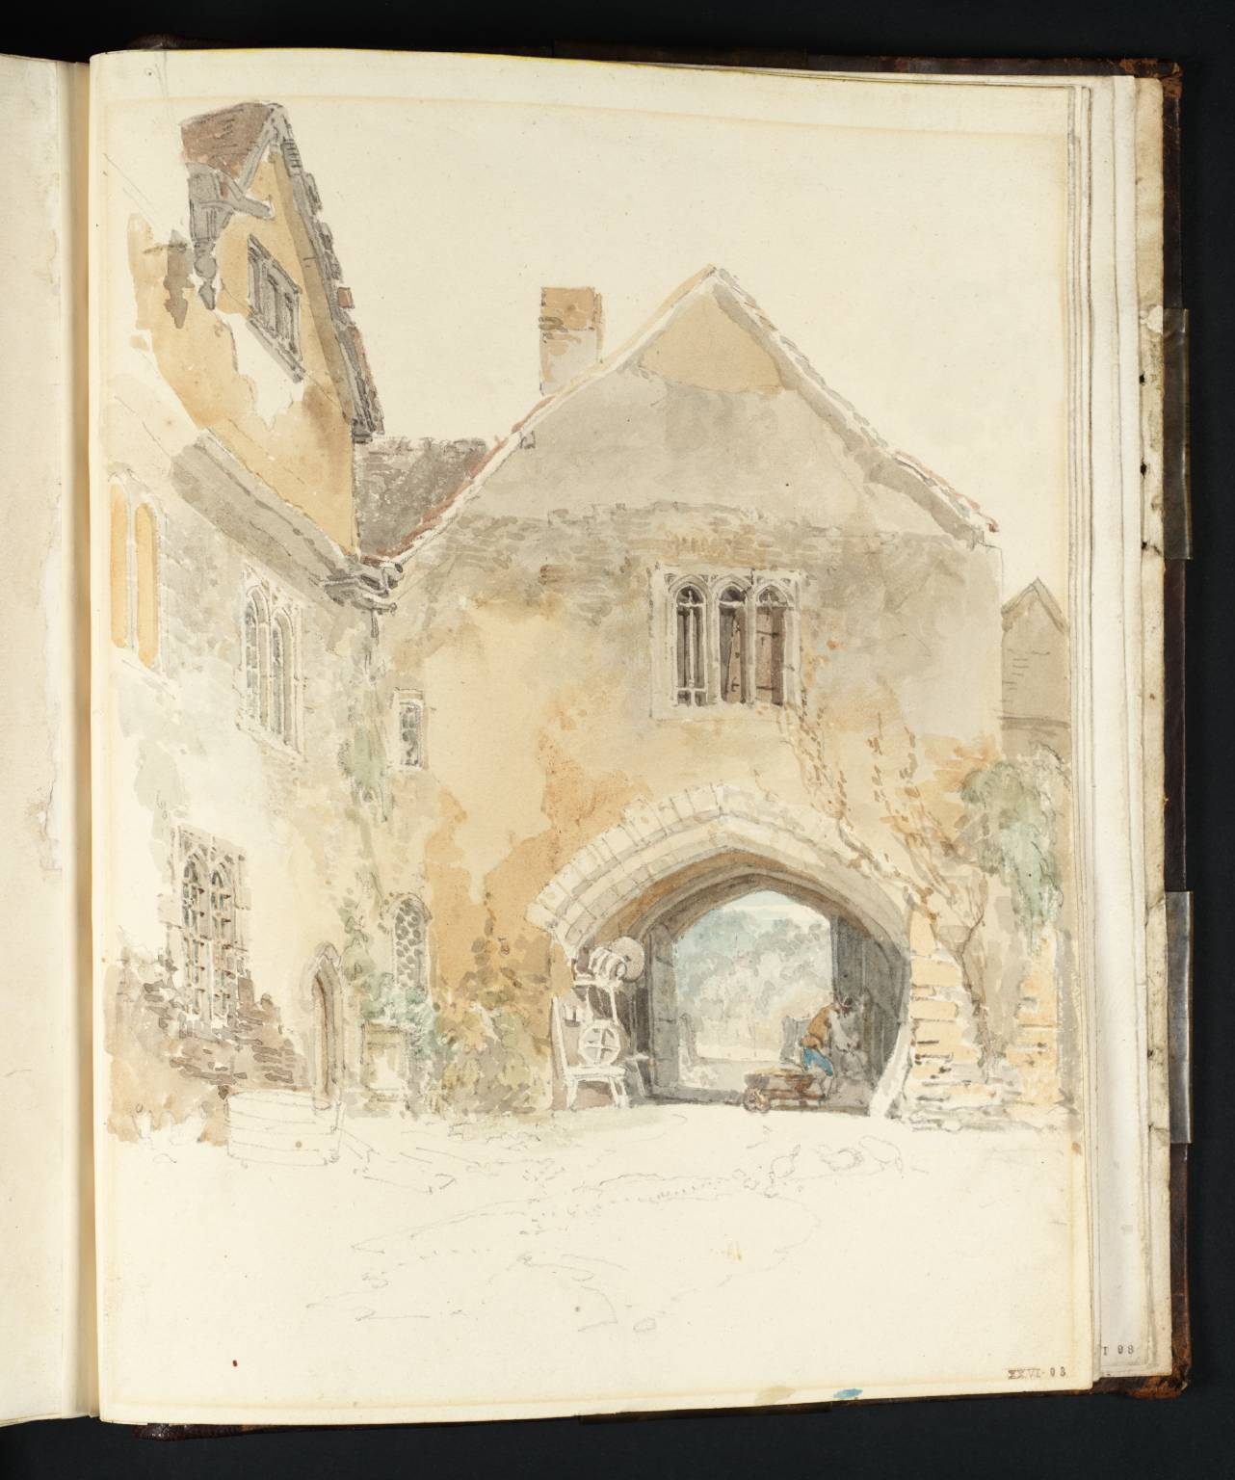
Allington Castle near Maidstone, 1798 Tate Britain

Slide 9
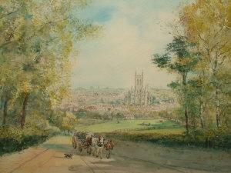
A distant view of Canterbury, perhaps from Harbledown. Tate Britain c.1830 S.J. Nash c.1870- 1960

Slide 10
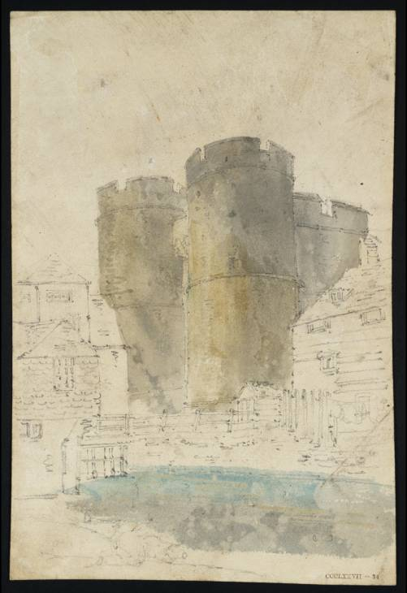
Turner: West Gate, Canterbury. Thomas Girtin : West Gate, c.1797

Slide 11
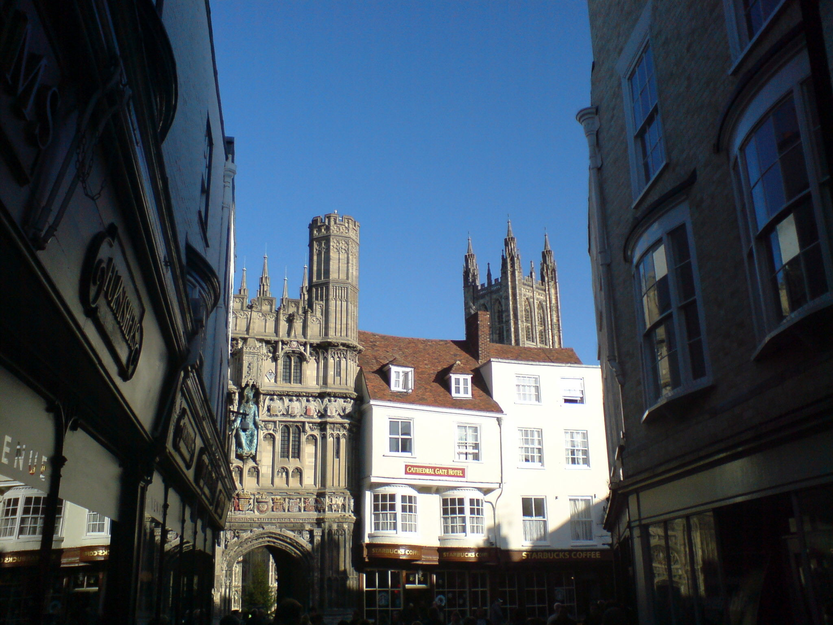

Slide 12
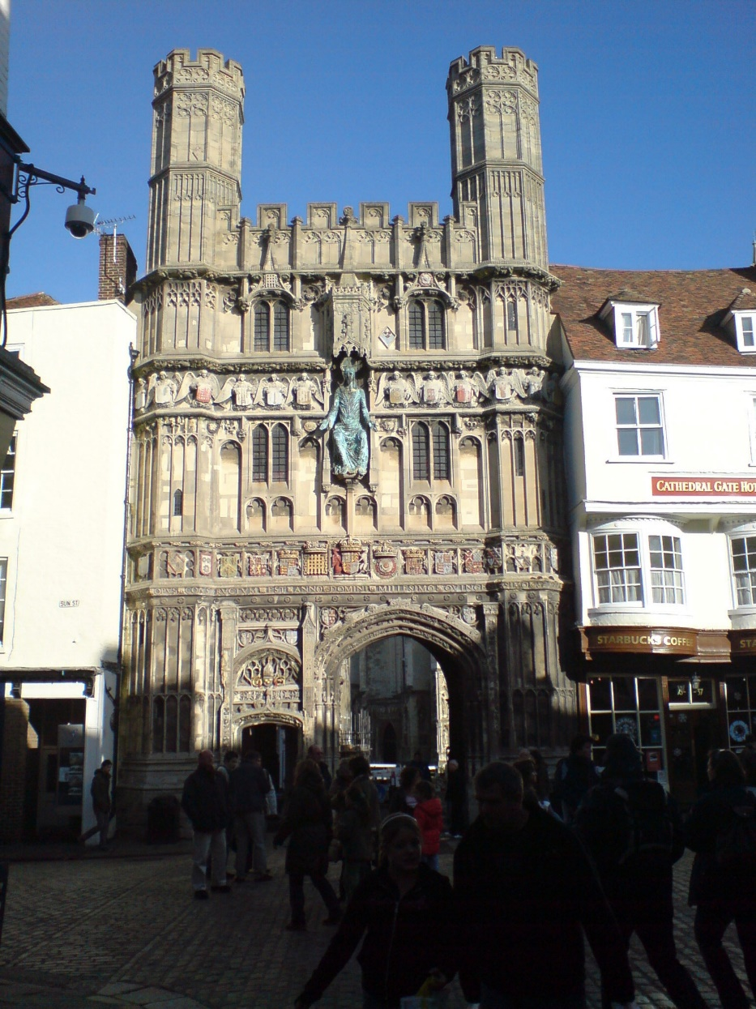
Christ Church Gate, exhibited at RA in 1794. Fitzwillliam Museum, Cambridge.

Slide 13
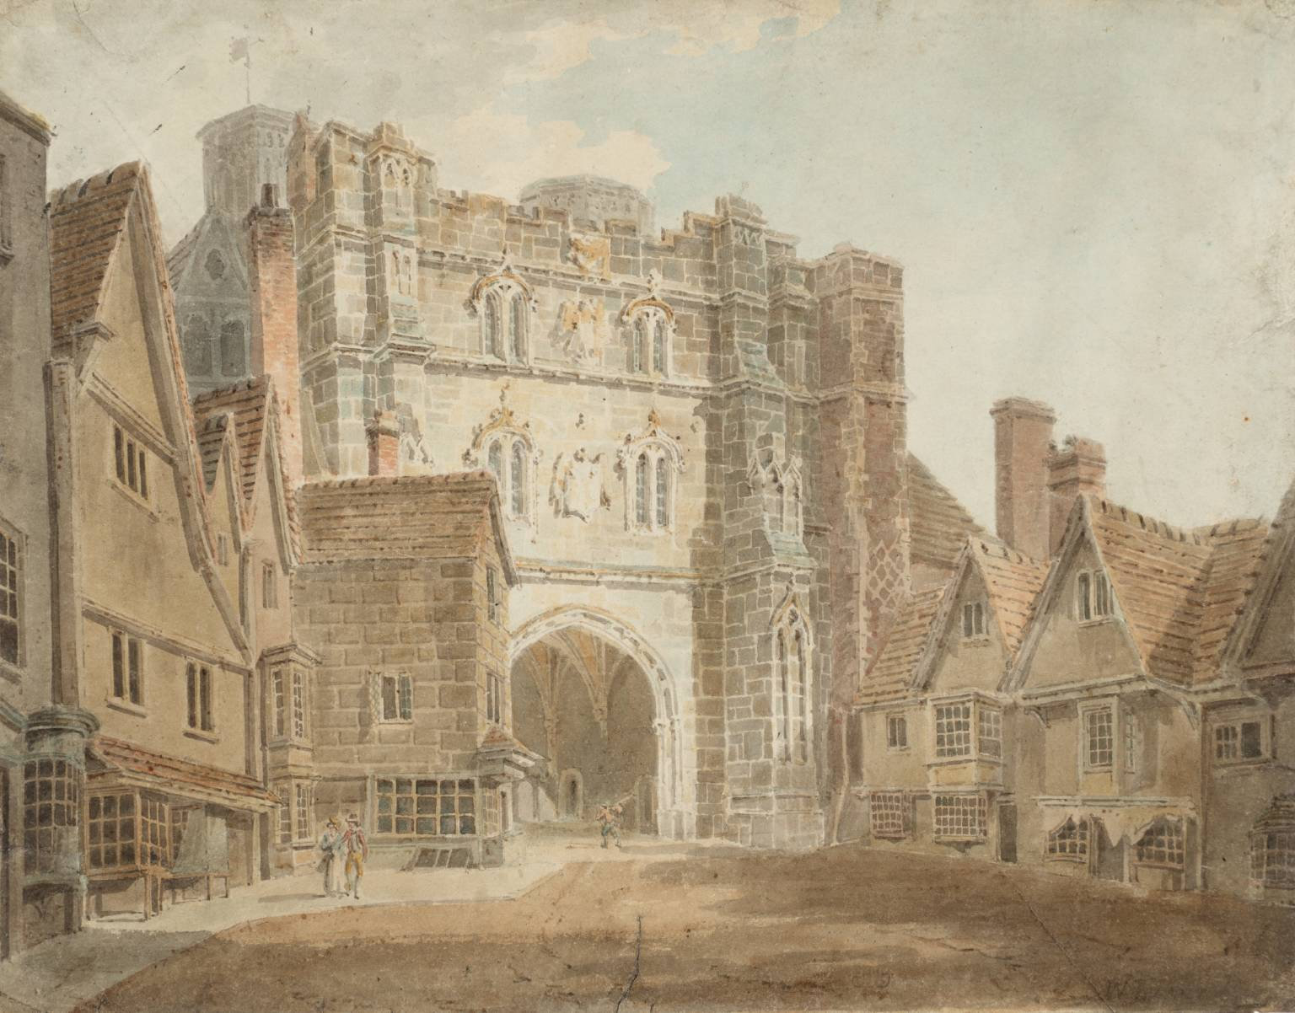
Turner, c.1792 Childe Hassam Christ Church Gate, c.1880 Boston Museum

Slide 14
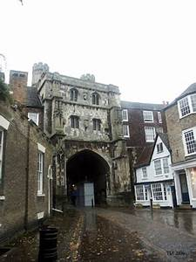
Christ Church Gate from within the Precincts, 1792. Tate Britain

Slide 15
Christ Church Gate, c.1830 Tate Britain This sketch may have been from a bundle of loose leaf sheets bound together in the 1830s and not necessarily evidence of Turner having revisited Canterbury but as Allen Warrell formerly curator at Tate Britain suggests, a nostalgic revisiting of scenes he knew from earlier times.

Slide 16
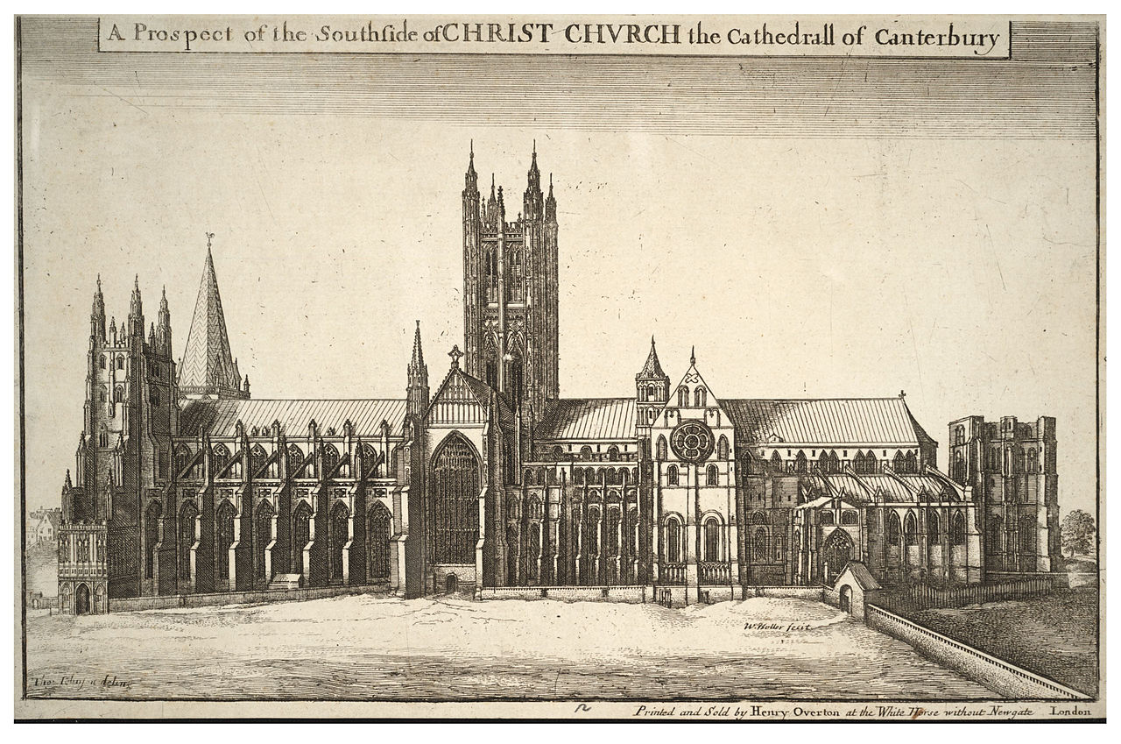
Canterbury Cathedral, St Anselm’s Chapel c,1794. Whitworth Art Gallery, Manchester. engraving by Wenzel Hollar c.1660

Slide 18
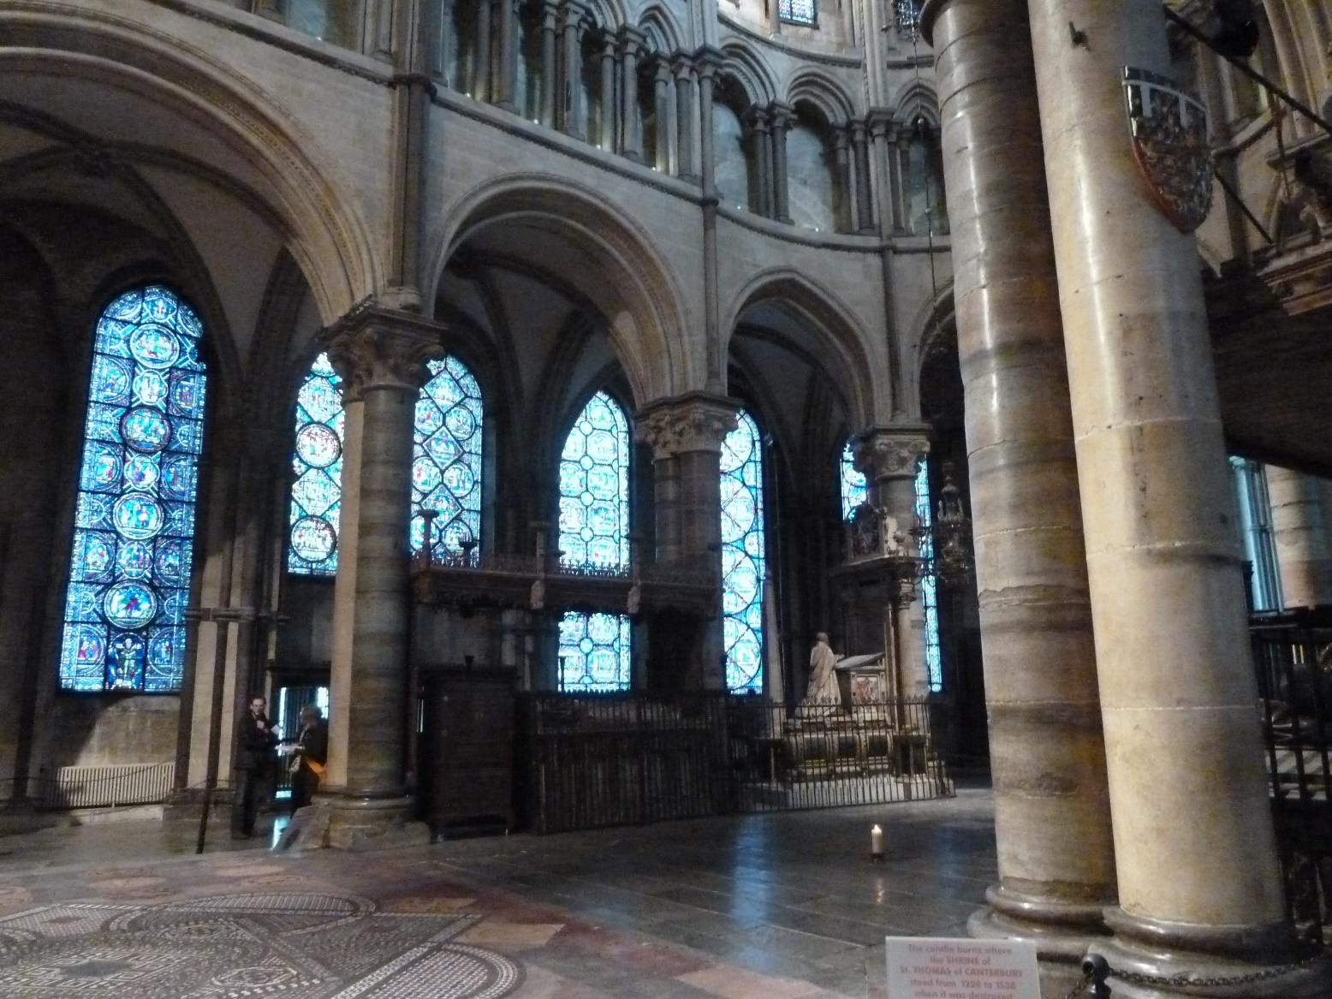
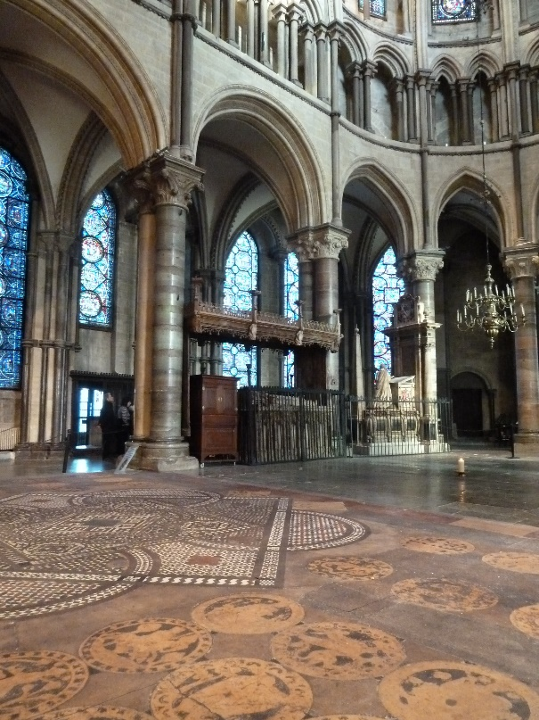
Canterbury Cathedral, Quire, Becket’s Crown c.1792-94

Slide 19
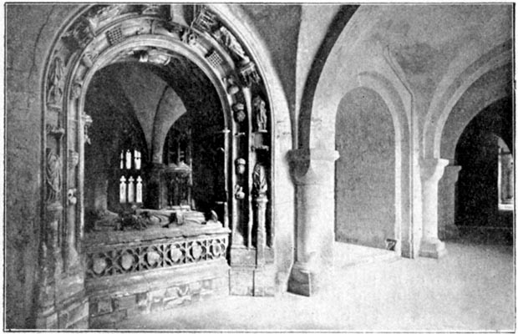
Canterbury Cathedral Crypt; Cardinal Moreton’s Tomb, 1798? Tate Britain catalogued as to 1798 by Andrew Wilton but may be earlier. Turner was in Kent in 1798 when he visited the Rev. Robert Nixon at Foots Cray and drew in the Medway valley and Aylesford.

Slide 20
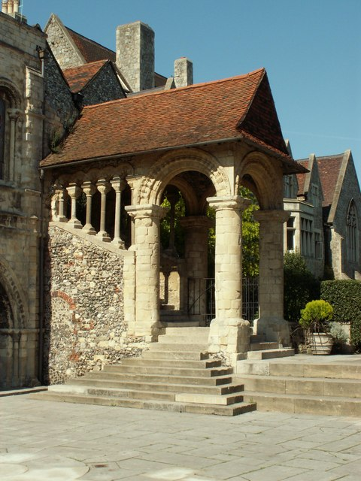
The Norman Staircase at the North Hall. Tate Britain, sketchbook Catalogue dated 1830

Slide 21
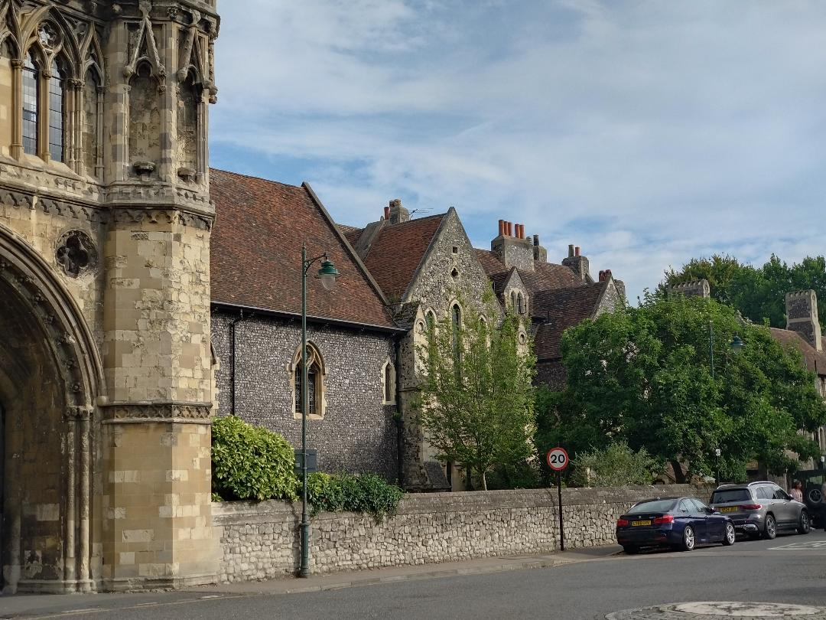
St Augustine’s Abbey c.1794

Slide 22
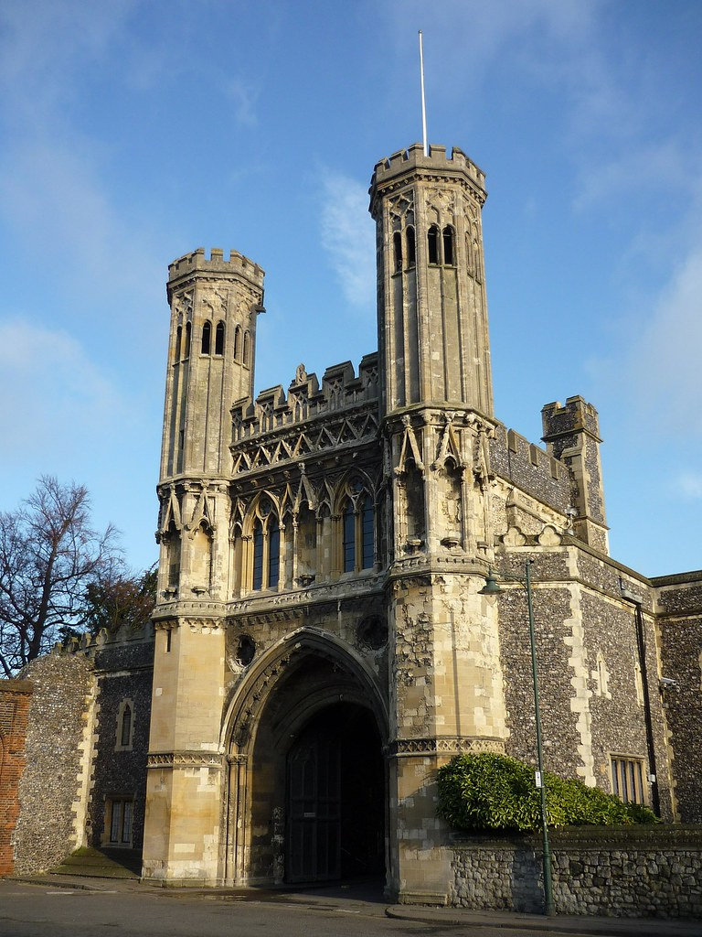
St Augustine’s Abbey ,Fyndon’s Gate

Slide 23
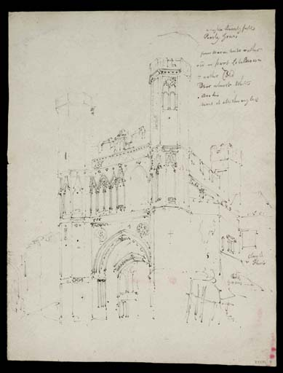

Slide 24
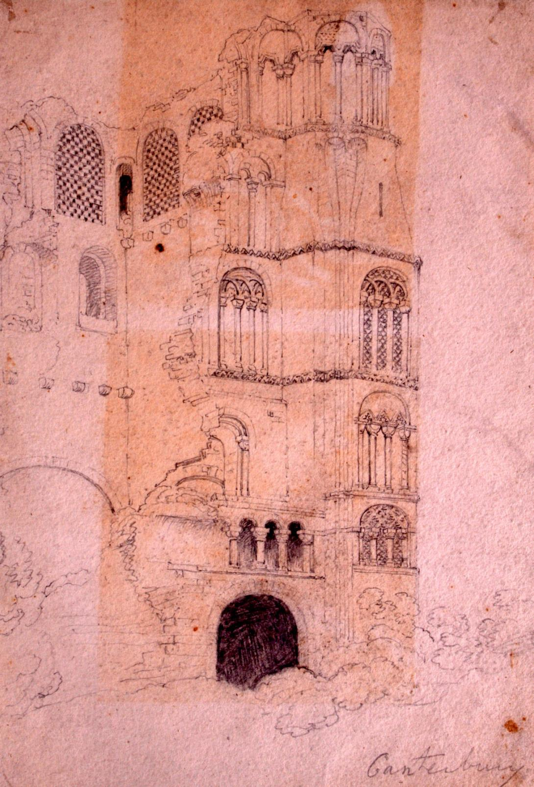
Ruins of St Augustine’s Abbey. c 1793 Tate Britain It is hard to identify the specific viewpoint. St Ethelbert’s tower partially collapsed in c.1803 and was completely demolished between 1823-24. St Ethelbert’s Tower c. 1820 , Thomas Shotter Boys, 1803-74 private collection

Slide 25
The Great gateway of St Augustine’s Abbey with Canterbury Cathedral beyond. Tate Britain, 1830

Slide 26
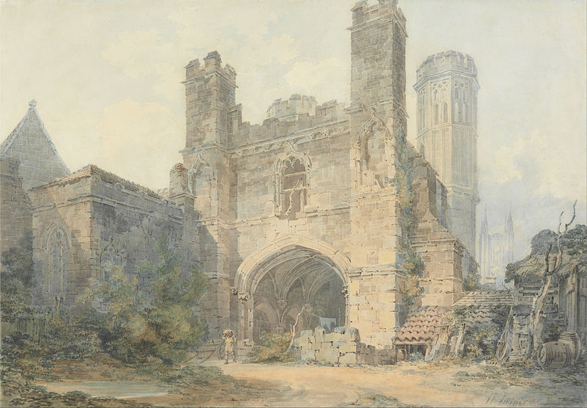
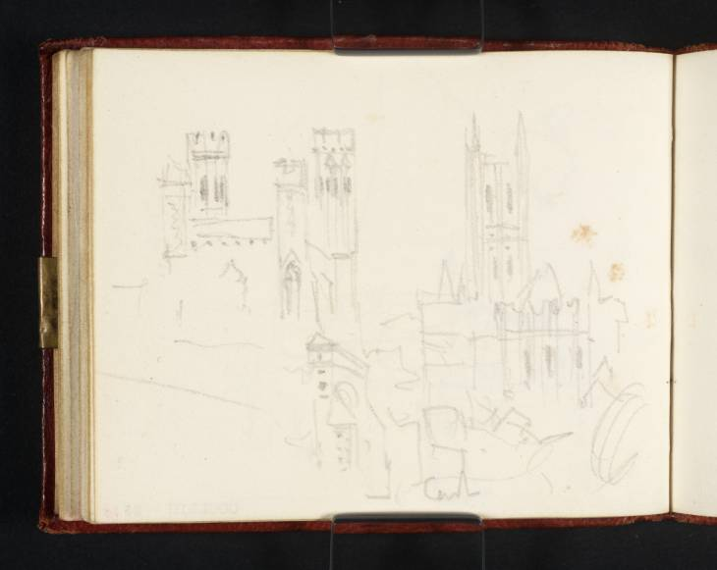
St Augustine’s Gateway, Canterbury. 1792 - 93. Yale Centre for British Art. Exhibited at the Royal Academy in 1793.

Slide 27
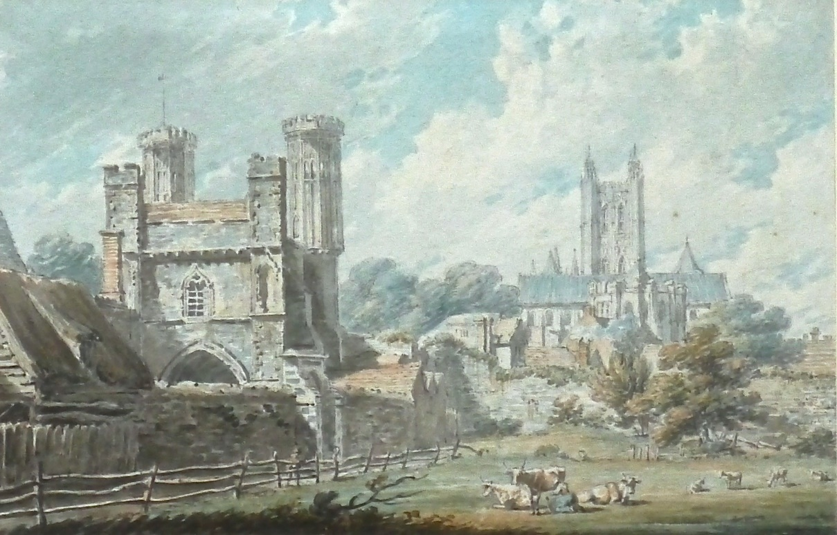
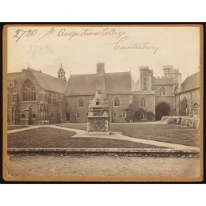
Turner : St Augustine’s Abbey , 1793 Yale. Edward Dayes : St Augustine’s Abbey, c.1800

Slide 28
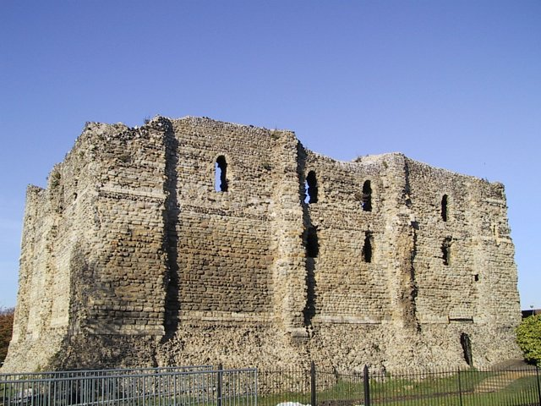
Canterbury Castle c.1830, Tate Britain

Slide 29
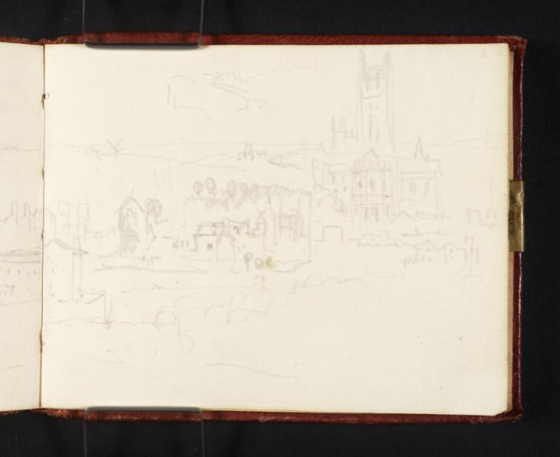
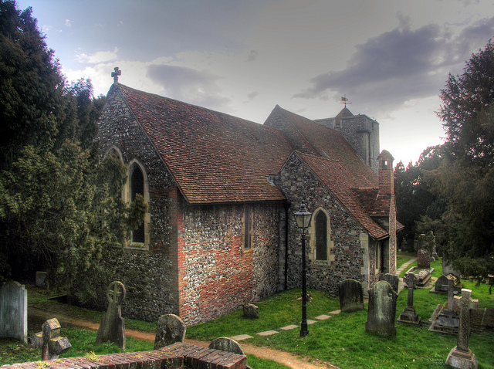
Canterbury from St Martin’s Church

Slide 30
Sturry with mill & view towards St Nicholas Church. C.1830 Tate Britain

Slide 31
Dover c. 1825. Tate Britain

Slide 32
Margate, c. 1790. Tate Britain This is extremely early and rather amateur by the standard of what he was to achieve within a few years.

Slide 33
Margate, c.1822 Yale Centre for British Art.

